Slide 1
DEEP LEARNING SERIES
YOLO Object Detection
A Deep Learning Deep Dive
Mastering YOLO for Technical Interviews & Exams
Deep Learning
Computer Vision
Interview Prep

Slide 2
Contents
01
Introduction to Object Detection
02
YOLO Architecture & Core Concepts
YOLO's revolutionary approach vs traditional methods
Network design, grid division, spatial responsibility
03
Bounding Boxes & Localization
04
Confidence Scores & Probabilities
Coordinate predictions, anchor boxes
Objectness, class probabilities, final scores
05
Intersection over Union (IoU)
06
Non-Maximum Suppression (NMS)
Measuring box overlap quality
Eliminating duplicate detections
07
YOLO Loss Function
08
YOLO Evolution: v1 to v8
Multi-part loss: coordinates, confidence, classification
Version comparison and improvements
09
Limitations & Challenges
10
Top Interview Questions
Understanding YOLO's weaknesses
Most frequently asked YOLO questions

Slide 3
01
Introduction to
Object Detection
Understanding the fundamentals of object detection
and YOLO's revolutionary approach

Slide 4
1.1 FOUNDATIONS
What is Object Detection?
Definition
Traditional vs YOLO Approach
Object detection combines image classification (what is it?) and localization (where is it?).
1
Traditional (R-CNN)
Output: Bounding boxes + class labels for all objects in an image
Stage 1: Generate region proposals (2k regions)
Stage 2: Classify each region
Result: Slow (~10 FPS)
YOLO's Innovation
YOLO (You Only Look Once) treats detection as a single regression problem through one CNN forward pass.
45-150
25ms
1
YOLO (Single Stage)
FPS
Latency
One Pass: CNN processes entire image
Output: All boxes + classes simultaneously
Key Insight
Result: Real-time (45+ FPS)
Traditional methods use two stages (region proposal + classification). YOLO processes the entire image at once, predicting all bounding boxes and classes simultaneously.
YOLO's speed comes from eliminating the region proposal bottleneck

Slide 5
1.2 ADVANTAGES
Why YOLO? Key Advantages
1. Real-Time Speed
4. Strong Generalization
YOLO achieves 45 FPS on standard version and up to 150 FPS with Fast YOLO variant using Titan X GPU.
When trained on natural images and tested on artwork, YOLO significantly outperforms traditional detection models like DPM and R-CNN.
45
150
25
Demonstrates robust feature learning across domains
FPS (Base)
FPS (Fast)
ms Latency
Speed Comparison
2. End-to-End Training
R-CNN
~0.5 FPS
Unlike R-CNN which requires separate training for region proposal and classification networks, YOLO trains as a single unified model .
Fast R-CNN
~2 FPS
Simplified pipeline, easier optimization
Faster R-CNN
~7 FPS
YOLO
45 FPS
3. Global Reasoning
YOLO processes the entire image at once, capturing both object appearance and contextual information. This holistic approach reduces background errors common in sliding window methods.
YOLO's speed advantage: 90x faster than R-CNN

Slide 6
02
YOLO Architecture &
Core Concepts
Deep dive into YOLO's network design
and prediction mechanism

Slide 7
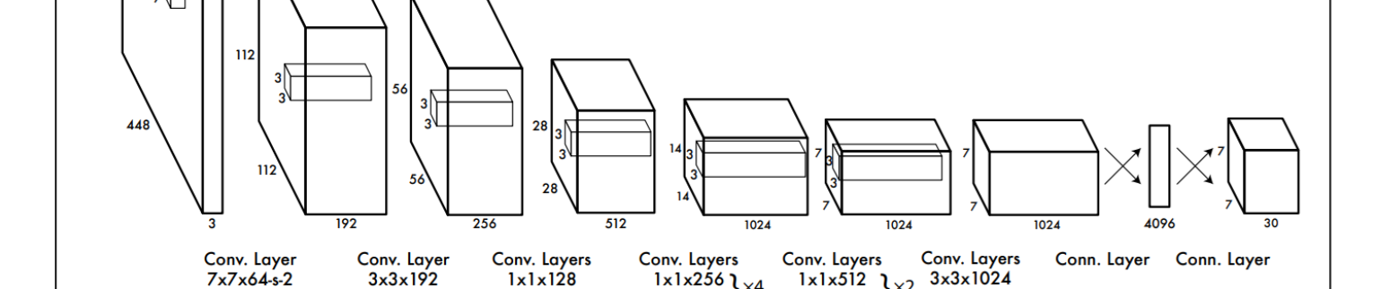
2.1 ARCHITECTURE
YOLO Network Architecture
YOLOv1 Architecture (24 Conv + 2 FC Layers)
Complete Pipeline
1
Input
448×448×3 image
2
CNN Feature Extraction
24 Conv layers
Feature Extraction
Prediction Head
3
FC Layers
2 Fully connected
24 Conv Layers inspired by GoogLeNet, using 1×1 reduction + 3×3 convolutions instead of inception modules.
2 FC Layers output S×S×(B×5+C) tensor containing all predictions in one pass.
4
Output Tensor
7×7×30 predictions
Fast YOLO Variant
Output Tensor Shape
Uses 9 convolutional layers with fewer filters. Same hyperparameters as YOLO but 3x faster with slightly lower accuracy.
S × S × (B×5 + C)
S×S:
7×7 grid
B:
2 boxes/cell
5:
x,y,w,h,conf
C:
20 classes
Total:
7×7×30

Slide 8
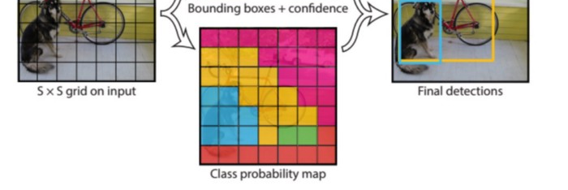
2.2 GRID DIVISION
Grid Division: The Foundation of YOLO
How Grid Division Works
Grid Cell Predictions
Each grid cell predicts:
B
B Bounding Boxes
Each with 5 parameters
C
C Class Probabilities
Conditional on object presence
Figure 2: YOLO divides image into S×S grid, each cell predicts B boxes + C classes
Mathematical Formulation
Key Principle
Output Shape = S × S × (B×5 + C)
Each grid cell is responsible for detecting objects whose center falls within it. This enforces spatial diversity in predictions.
S×S: Grid size (e.g., 7×7)
B: Boxes per cell (typically 2-5)
Most objects fall into one cell; large objects may span multiple cells
5: x, y, w, h, confidence
C: Number of classes
Example (YOLOv1): S=7, B=2, C=20 → Output = 7×7×30 tensor

Slide 9
03
Bounding Boxes &
Localization
Understanding how YOLO predicts object locations

Slide 10
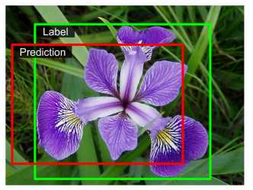
3.1 BOUNDING BOXES
Bounding Box Predictions
5 Components Per Box
Bounding Box Visualization
x
x coordinate
Center x relative to grid cell
Offset from left edge of grid cell, normalized [0, 1]
y
y coordinate
Center y relative to grid cell
Offset from top edge of grid cell, normalized [0, 1]
Ground truth (green) vs Prediction (red)
w
width
Relative to image width
Why Square Root for w, h?
Box width as fraction of full image width
The loss function uses √w and √h instead of raw w, h to address a critical issue:
h
height
Problem: Small deviations matter more for small boxes than large boxes.
Relative to image height
Example: A 2-pixel error in a 10×10 box (20% deviation) is worse than in a 100×100 box (2% deviation).
Box height as fraction of full image height
c
confidence
Solution: Square root reduces the impact of large box errors while preserving sensitivity to small box errors.
Objectness score
P(object) × IoU(pred, truth) - probability box contains object and accuracy

Slide 11
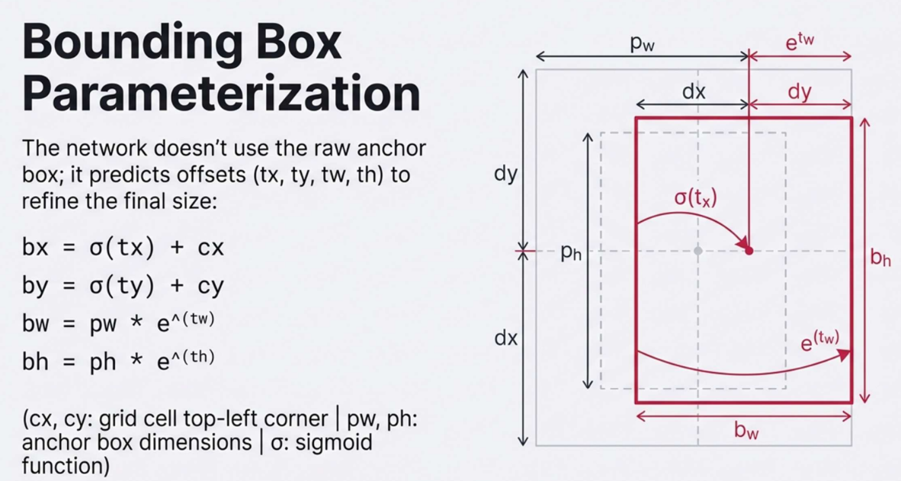
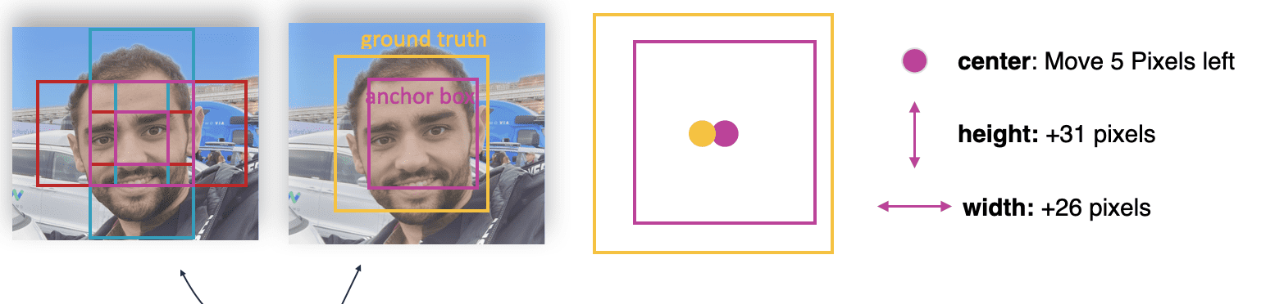
3.2 ANCHOR BOXES
Anchor Boxes: Handling Multiple Object Shapes
Anchor Box Prediction Formula
What are Anchor Boxes?
Anchor boxes are pre-defined bounding box shapes with different aspect ratios, introduced in YOLOv2 .
bₓ = σ(tₓ) + cₓ - Center x offset
Each anchor specializes in detecting objects of specific shapes
bᵧ = σ(tᵧ) + cᵧ - Center y offset
b_w = p_w × e^(t_w) - Width scaling
How Anchor Boxes Work
b_h = p_h × e^(t_h) - Height scaling
1
Learned via k-means clustering on training data bounding boxes
p_w, p_h: Anchor box dimensions
2
Each anchor has specific width, height, aspect ratio
t_x, t_y, t_w, t_h: Network predictions
c_x, c_y: Grid cell offset
3
Network predicts offsets from anchor box dimensions
4
Responsible predictor: anchor with highest IoU handles prediction
COCO Dataset Anchors (YOLOv3)
10×13
16×30
33×23
Small
Tall
Wide
30×61
62×45
59×119
Medium
Square
Large

Slide 12
04
Confidence Scores &
Probabilities
Decoding YOLO's prediction scores

Slide 13
4.1 CONFIDENCE SCORES
Understanding Confidence Scores
Objectness Score (Confidence)
Final Class Score
Confidence = P(object) × IoU(pred, truth)
score(classᵢ) = confidence × P(classᵢ | object)
Combined score for each class in each box
The objectness score represents two things simultaneously:
P(object)
During Training
Probability that box contains an object
Confidence is trained to equal IoU between predicted and ground truth boxes.
IoU(pred, truth)
During Inference
How accurate the predicted box is
Confidence becomes the model's estimate of object presence and box quality.
Class Probabilities
Each grid cell also predicts class probabilities conditional on an object being present:
Thresholding & Filtering
P(classᵢ | object)
After predictions, we apply a confidence threshold (typically 0.5) to filter out low-confidence detections:
For COCO dataset with 80 classes, each cell outputs 80 class probabilities.
If confidence < 0.5:
DISCARD
If confidence ≥ 0.5:
KEEP
Note: A box can have high class probability but still be filtered out if objectness is low.

Slide 14
05
Intersection over
Union (IoU)
The metric that powers object detection evaluation

Slide 15
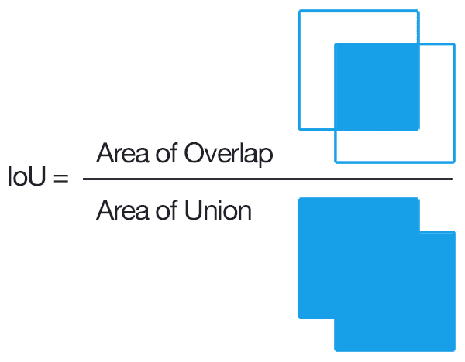
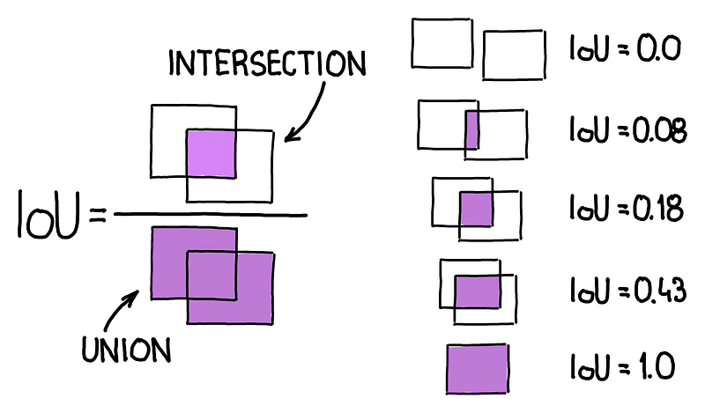
5.1 IOU CALCULATION
IoU: Measuring Box Overlap
IoU Formula & Concept
IoU Examples
IoU = |A ∩ B| / |A ∪ B|
Intersection Area / Union Area
IoU = 0.0
IoU = 0.08
No overlap
Minimal overlap
IoU = 0.43
IoU = 1.0
0
1
Moderate overlap
Perfect match
No Overlap
Perfect Match
IoU Thresholds in Practice
Step-by-Step Calculation
IoU < 0.5
False Positive
1
Find intersection: max(x₁ₘᵢₙ, x₂ₘᵢₙ), max(y₁ₘᵢₙ, y₂ₘᵢₙ)
Prediction doesn't sufficiently overlap with ground truth
2
Calculate intersection area: width × height
True Positive
3
Calculate union: Area₁ + Area₂ - Intersection
IoU ≥ 0.5
Prediction correctly identifies the object
4
Compute IoU: Intersection / Union

Slide 16
06
Non-Maximum
Suppression (NMS)
Eliminating duplicate detections

Slide 17
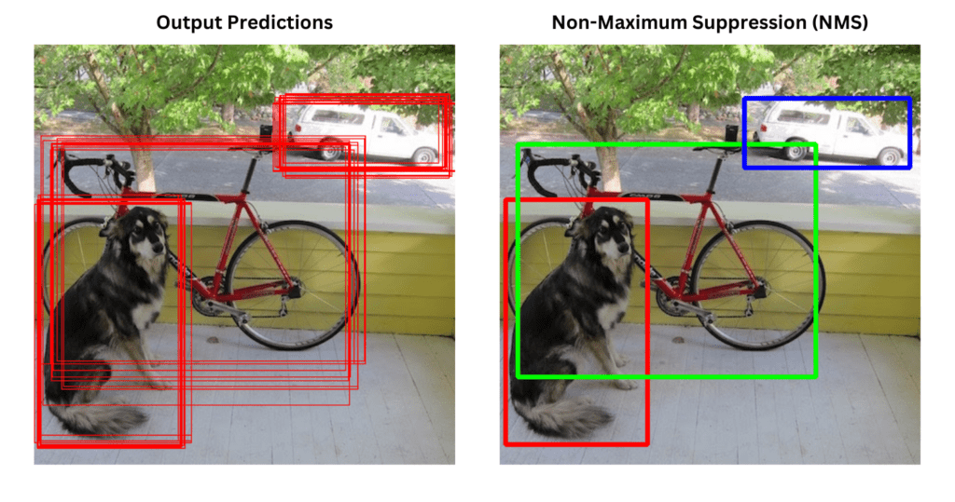
6.1 NMS ALGORITHM
How NMS Works
NMS Visualization
NMS Algorithm Steps
1
Sort by Confidence
Sort all predictions by confidence score in descending order.
2
Select Highest
Select the box with highest confidence as a final detection.
Before NMS (multiple boxes) → After NMS (one box per object)
3
Calculate IoU
Calculate IoU between selected box and all remaining boxes.
Why NMS is Needed
YOLO predicts 98 boxes (v1) or hundreds of boxes (later versions), but most detect the same objects. Without NMS, we'd have multiple overlapping boxes for each object.
4
Suppress Overlapping
Remove boxes with IoU > threshold (typically 0.5) - they detect the same object.
NMS improves mAP by 23% in YOLOv1
5
Repeat
Repeat steps 2-4 until no boxes remain.
NMS Benefits
// Input: boxes[], scores[], threshold
Reduces redundancy: One box per object
NMS Pseudocode
Improves precision: Keeps best prediction
// Output: selected_boxes[]
while boxes not empty:
Computational efficiency: Fewer boxes to process
pick = argmax(scores)
selected_boxes.append(boxes[pick])
ious = compute_iou(boxes[pick], boxes)
remove boxes where ious > threshold

Slide 18
07
YOLO Loss
Function
How YOLO learns to detect objects

Slide 19
7.1 LOSS FUNCTION
Multi-Part Loss Function
Complete Loss Formula
Loss Components
Loss = λcoord × Σ[1iobj × ((x-x̂)² + (y-ŷ)²)]
1. Localization Loss
+ λcoord × Σ[1iobj × ((√w-√ŵ)² + (√h-ĥ)²)]
First 2 terms: x, y, w, h
+ Σ[1iobj × (C-Ĉ)²]
2. Confidence Loss
+ λnoobj × Σ[1inoobj × (C-Ĉ)²]
Terms 3 & 4: Object vs No Object
+ Σ[1iobj × Σ(p(c)-p̂(c))²]
3. Classification Loss
λcoord = 5
λnoobj = 0.5
Term 5: Class probabilities
Increase coordinate importance
Decrease empty cell weight
Indicator Functions
Coordinate Loss
Size Loss
1iobj = 1 if object in cell i
MSE for (x, y): Penalizes center coordinate deviations.
MSE for (√w, √h): Square root reduces bias toward large boxes.
(x - x̂)² + (y - ŷ)²
1inoobj = 1 if no object in cell i
(√w - √ŵ)² + (√h - ĥ)²
1ijobj = 1 if box j in cell i is responsible
Confidence (Object)
Confidence (No Object)
MSE for cells with objects: High confidence if IoU is high.
MSE for empty cells: Low confidence with λnoobj = 0.5.
Why These Weights?
(C - Ĉ)² where 1iobj = 1
λnoobj × (C - Ĉ)² where 1inoobj = 1
λcoord = 5: Localization is more important
λnoobj = 0.5: Most cells are empty; don't overweight them
Note: Loss is only computed for the "responsible" predictor (box with highest IoU) in each cell.

Slide 20
08
YOLO Evolution
From YOLOv1 (2015) to YOLOv8 (2023)

Slide 21
8.1 VERSION COMPARISON
YOLO Version Comparison
Version | Year | Key Improvements | Speed | mAP
YOLOv1 | 2015 | Original single-stage detector, 24 conv layers | 45 FPS | 63.4
YOLOv2 | 2016 | Anchor boxes, batch normalization, multi-scale training | 40 FPS | 78.6
YOLOv3 | 2018 | Darknet-53, 3-scale detection, independent classifiers | 30 FPS | 81.2
YOLOv4 | 2020 | CSPDarknet53, SPP, PANet, mosaic augmentation | 65 FPS | 87.3
YOLOv5 | 2020 | PyTorch implementation, auto-anchor, CSP backbone | 140 FPS | 88.0
YOLOv8 | 2023 | Anchor-free, C2f module, decoupled head, instance seg | 120 FPS | 88.5
YOLOv2 Improvements
YOLOv3 Improvements
YOLOv4/v5/v8
Anchor boxes (k-means)
Darknet-53 backbone
CSPDarknet backbone
Batch normalization
3-scale detection
SPP & PANet
High resolution classifier
Independent logistic classifiers
Mosaic augmentation
Multi-scale training
Better small object detection
Anchor-free (v8)

Slide 22
09
Limitations &
Challenges
Understanding YOLO's weaknesses

Slide 23
9.1 LIMITATIONS
YOLO's Key Limitations
1. Small Object Detection
4. Localization Errors
Problem: YOLO struggles with tiny objects or groups of small objects (e.g., flock of birds) due to spatial constraints.
Problem: Loss function treats small and large box errors equally, leading to incorrect localizations.
Why: A 2-pixel error in a 10×10 box (20%) is worse than in a 100×100 box (2%), but loss treats them equally.
Why: Small objects may occupy a single grid cell with insufficient pixel information after downsampling through CNN layers.
Solutions: Square root of w,h in loss (YOLOv1), GIoU/DIoU/CIoU losses (later versions)
Solutions: Multi-scale training, Feature Pyramid Networks (FPN), higher resolution inputs
5. Limited Context
2. Overlapping Objects
Problem: Processes grid cells independently, lacking global context awareness for complex scenes.
Problem: Difficulty distinguishing closely packed or overlapping objects in the same grid cell.
Example: In a scene with a person holding a bicycle, YOLO might misclassify the bicycle as separate or fail to detect it if partially obscured.
Example: In a dense crowd, YOLO might struggle to draw distinct bounding boxes for each person.
Solutions: Attention mechanisms, transformer-based detectors, larger receptive fields
Solutions: More anchor boxes, higher grid resolution, instance segmentation
Performance Summary
3. Unusual Aspect Ratios
Small objects
Weak
Problem: Predefined anchor boxes may miss objects with extreme shapes (very tall, very wide).
Moderate
Overlapping objects
Solutions: Custom anchor boxes via k-means, anchor-free detectors (YOLOv8)
Real-time speed
Excellent

Slide 24
10
Top Interview
Questions
Most frequently asked YOLO questions

Slide 25
10.1 INTERVIEW Q&A - PART 1
Essential Interview Q&A (Part 1)
Q1
How does YOLO differ from R-CNN?
YOLO is single-stage: One forward pass through CNN predicts all bounding boxes and classes simultaneously (45 FPS). R-CNN is two-stage: First generates region proposals (2k regions), then classifies each region (~0.5 FPS). YOLO is 90x faster but slightly less accurate on small objects.
Q2
What does "You Only Look Once" mean?
It means YOLO processes the entire image in a single forward pass through the CNN. Unlike traditional methods that scan the image multiple times (sliding window) or use separate stages (region proposal + classification), YOLO looks at the image once and predicts all objects simultaneously.
Q3
Explain grid cell responsibility.
The image is divided into an S×S grid. Each grid cell is responsible for detecting objects whose center falls within that cell. Each cell predicts B bounding boxes and C class probabilities. This enforces spatial diversity - most objects fall into one cell, while large objects may span multiple cells.
Q4
What is IoU and why is it important?
IoU (Intersection over Union) = Area of Intersection / Area of Union. Range: 0 (no overlap) to 1 (perfect match). It's used for: (1) Assigning positive/negative labels during training (IoU > 0.5 = positive), (2) Evaluating prediction accuracy (mAP calculation), (3) NMS algorithm to remove duplicate detections.
Q5
Why use square root for w,h in loss function?
A small deviation matters more for small boxes than large boxes. Example: 2-pixel error in 10×10 box = 20% deviation (significant), but in 100×100 box = 2% deviation (minor). Using √w and √h reduces the impact of large box errors while preserving sensitivity to small box errors, ensuring fair penalization across all box sizes.

Slide 26
10.2 INTERVIEW Q&A - PART 2
Essential Interview Q&A (Part 2)
Q6
How does NMS work and why is it needed?
NMS (Non-Maximum Suppression) removes duplicate detections: (1) Sort boxes by confidence, (2) Select highest confidence box, (3) Remove boxes with IoU > threshold (typically 0.5), (4) Repeat until no boxes remain. It's needed because YOLO predicts hundreds of boxes, but most detect the same objects. NMS improves mAP by 23% in YOLOv1.
Q7
What are anchor boxes?
Anchor boxes are pre-defined bounding box shapes learned via k-means clustering on training data. Introduced in YOLOv2, they have different aspect ratios (tall, wide, square) to handle diverse object shapes. Each anchor specializes in detecting specific shapes. The network predicts offsets from anchor dimensions, and the anchor with highest IoU becomes the "responsible predictor."
Q8
Explain confidence score formula.
Confidence = P(object) × IoU(pred, truth). It combines: (1) P(object) - probability that box contains an object, (2) IoU(pred, truth) - how accurate the predicted box is compared to ground truth. During training, it's trained to equal IoU. During inference, it becomes the model's estimate of object presence and box quality. Final class score = confidence × P(class|object).
Q9
Why does YOLO struggle with small objects?
YOLO struggles with small objects due to: (1) Spatial constraints - small objects may occupy a single grid cell, (2) Downsampling - CNN pooling layers reduce spatial resolution, losing fine details, (3) Feature loss - small objects have fewer pixels, making feature extraction difficult. Solutions: Multi-scale training, Feature Pyramid Networks (FPN), higher resolution inputs.
Q10
Compare YOLOv3 and YOLOv4.
YOLOv3: Darknet-53 backbone, 3-scale detection, independent logistic classifiers, anchor boxes. YOLOv4: Adds CSPDarknet53 backbone (better gradient flow), SPP (Spatial Pyramid Pooling), PANet (Path Aggregation Network), mosaic augmentation, CIOU loss, and various training tricks (drop block, label smoothing). YOLOv4 achieves higher accuracy (87.3 vs 81.2 mAP) while maintaining real-time speed.

Slide 27
KEY TAKEAWAYS
Master YOLO,
Ace Your Interview
Single-Stage Detection
Grid-Based Predictions
Real-time speed through one CNN forward pass
Each cell responsible for objects in its region
Anchor Boxes
NMS
Handle diverse object shapes and sizes
Eliminates duplicate detections
Multi-Part Loss
Balances coordinates (λcoord=5), confidence, and classification
Good luck with your interviews!
Study Hard
Practice Coding
Succeed

